Slide 1

UNIVERSITY INSTITUTE OF ENGINEERING
COMPUTER SCIENCE ENGINEERING
Bachelor of Engineering
Design and Analysis of Algorithms(CST-302/ITT-302
Er. Amrita Chaudhary (E8745)
Topic: Introduction to Dijkstra and bellman ford
DISCOVER . LEARN . EMPOWER

Slide 2
Learning Objectives & Outcomes
Objective:
To understand meaning of Dijkstra and Bellman Ford
Outcome:
Student will understand the meaning of Dijkstra and Bellman Ford

Slide 3
Dijkstra’s Algorithm
Dijkstra’s algorithm solves the single-source shortest-paths problem on a directed weighted graph G = (V, E), where all the edges are non-negative (i.e., w(u, v) ≥ 0 for each edge (u, v) Є E).
In the following algorithm, we will use one function Extract-Min(), which extracts the node with the smallest key.

Slide 4
ANALYSIS
The complexity of this algorithm is fully dependent on the implementation of Extract-Min function. If extract min function is implemented using linear search, the complexity of this algorithm is O(V² + E).
In this algorithm, if we use min-heap on which Extract-Min() function works to return the node from Q with the smallest key, the complexity of this algorithm can be reduced further.

Slide 5
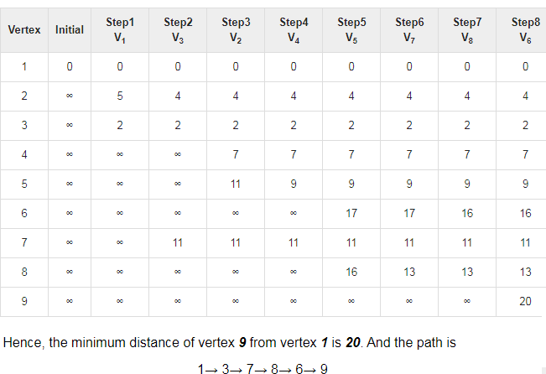
Example

Slide 6
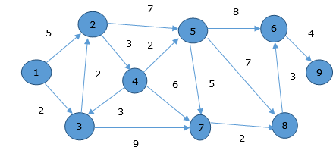
This path is determined based on predecessor information.

Slide 7
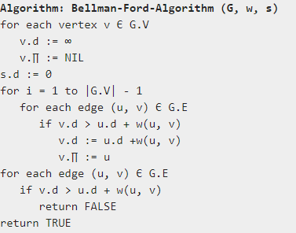
Bellman Ford Algorithm
This algorithm solves the single source shortest path problem of a directed graph G = (V, E) in which the edge weights may be negative. Moreover, this algorithm can be applied to find the shortest path, if there does not exist any negative weighted cycle.

Slide 8
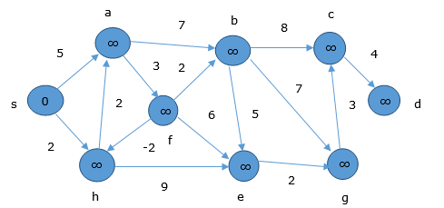
Example
At the time of initialization, all the vertices except the source are marked by ∞ and the source is marked by 0.
In the first step, all the vertices which are reachable from the source are updated by minimum cost. Hence, vertices a and h are updated.

Slide 9
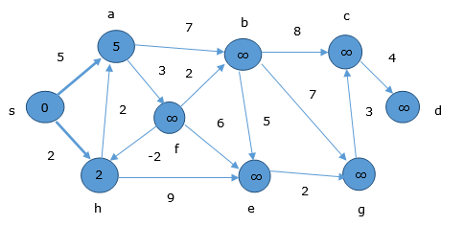
Example
.
In the next step, vertices a, b, f and e are updated.

Slide 10
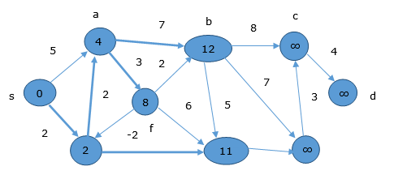
Example
.
Following the same logic, in this step vertices b, f, c and g are updated.

Slide 11
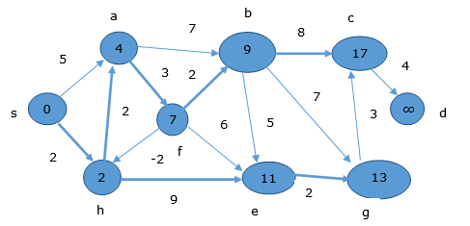
Example
.
Here, vertices c and d are updated.

Slide 12
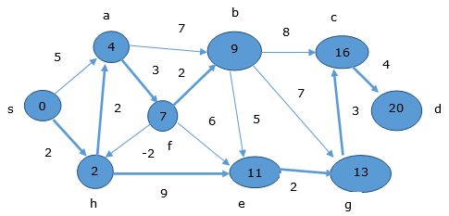
Example
.
Hence, the minimum distance between vertex s and vertex d is 20.
Based on the predecessor information, the path is s→ h→ e→ g→ c→ d

Slide 13
REFERENCES
Text books:
Cormen, Leiserson, Rivest, Stein, “Introduction to Algorithms”, Prentice Hall of India, 3rd edition 2012. problem, Graph coloring.
Websites:
https://www.javatpoint.com/dijkstras-algorithm
https://www.javatpoint.com/bellman-ford-algorithm

Slide 14
THANK YOU

